Slide 1


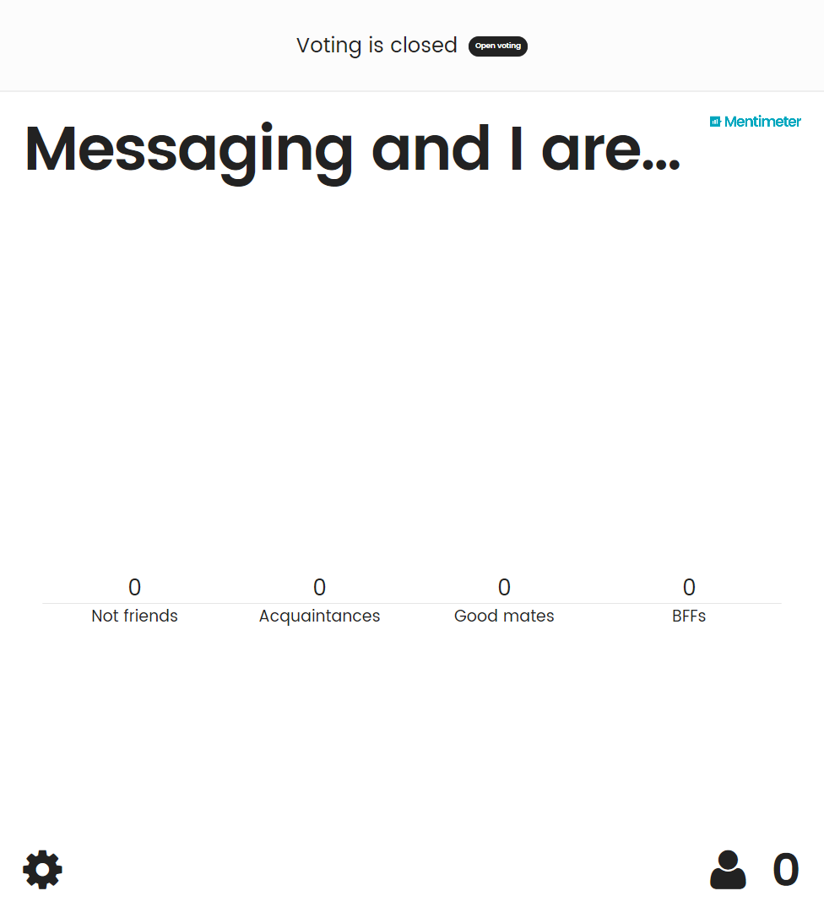
Thank You To Our Sponsors!
Notes:
Focus of this presentation is brokered messaging, not relayed messaging (Relays) or EventHubs

Slide 2

Azure Service Bus - The good, the Bad and the Awesome Sean Feldman, Azure Advisor & MVP
Sean Feldman

Slide 3
Disclaimer
Notes:
Focus of this presentation is brokered messaging, not relayed messaging (Relays) or EventHubs

Slide 4






Service provided by ASB
Brokered Messaging
EventHubs
Relays
Queues
Topics & Subscriptions
Notes:
Focus of this presentation is brokered messaging, not relayed messaging (Relays) or EventHubs

Slide 5
ASB Stats
>275 Billion
Message operations on Azure Service Bus Messaging (Standard) per month
1.5 Million
Message Queues and Topics in Production
>35,000
Daily Active Service Bus Namespaces
440 Billion
1.8 Million
>80,000
>250 TB
Daily Data Volume
>12 PB
Monthly Data Volume
28 PB

Slide 6
ASB Options & Tiers
On-Premises Infra and IaaS
Private Cloud
Public Cloud (Standard)
Public Cloud (Premium)
Service Bus for Windows Server 1.1
Windows Azure Pack Service Bus for Windows Server 1.1
Microsoft Azure Service Bus (PaaS)
Microsoft Azure Service Bus (PaaS)
Consistent Capabilities
Azure Pack / Windows Server Update Cycle
Azure Update Cycle

Slide 7
Capability Set
Batching | Send or receive a batch of multiple independent messages in a single transfer gesture
Deadlettering | Expired or undelivered messages (exceeding maximum delivery count) can be placed into this special queue for retrieval and inspection
Duplicate Detection | Duplicates of already received messages (same message-id) are suppressed and not accepted into the entity within a defined time window
Ephemeral Entities | Queues, Topics, and Subscriptions created for temporary use can be automatically deleted after having been idle (unused) for defined time
Message Expiration | Messages can be set to expire after a defined period. If the message has not been delivered at the deadline, the message is removed (or deadlettered)
Multiplexing and Order Preservation | Sessions allow separate flow of multiple, concurrent ordered sequences through a single entity
Scheduling | Scheduling permits placing a message into the queue and make it available for retrieval later, starting at a specified time
Transactions | Multiple operations on multiple distinct entities can be enveloped in a transaction and will either be executed or aborted together.
Auto-Forward | Native chaining of a queue or subscription to another queue or topic within the same namespace.

Slide 8
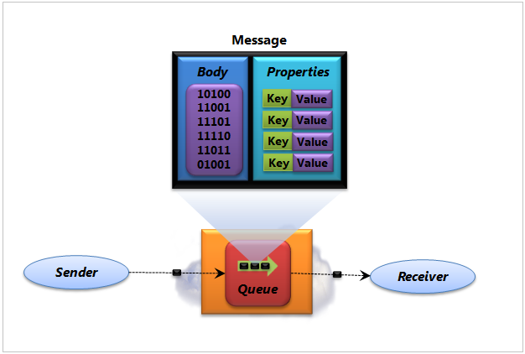
Queues

Slide 9
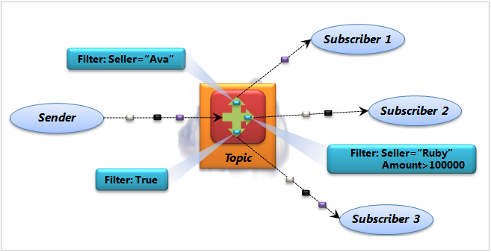
Topics and Subscriptions

Slide 10
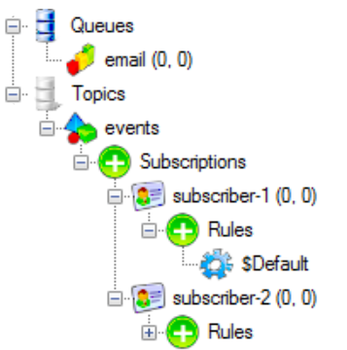
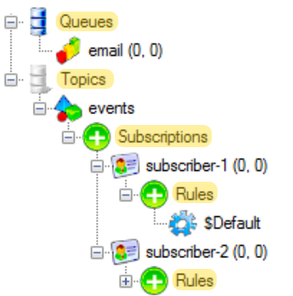
Entities

Slide 11
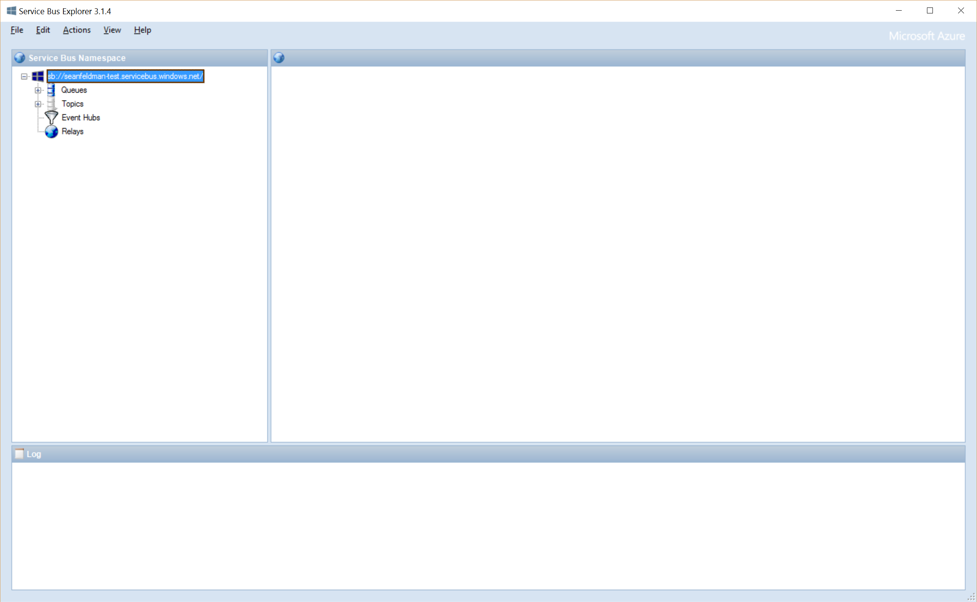
ServiceBus Explorer

Slide 12
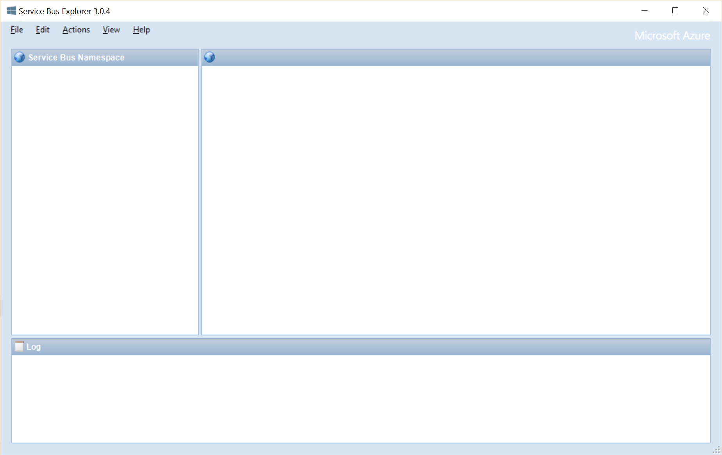
Entity Properties
 | Queue | Topic | Subscription
Path | Yes | Yes
Name |  |  | Yes
DefaultMessageTimeToLive | Yes | Yes | Yes
RequiredDuplicateDetection | Yes | Yes
DuplicateDetectionTimeHistoryWindows | Yes | Yes
MaxSizeInMegabytes | Yes | Yes
EnableDeadLetteringOnMessageExpiration | Yes |  | Yes
LockDuration | Yes |  | Yes
MaxDeliveryCount | Yes |  | Yes
RequiresSession | Yes |  | Yes
EnableDeadLetteringOnFilterEvaluationException |  |  | Yes
Demo

Slide 13
Common Types
NamespaceManager
QueueDescription
TopicDescription
SubscriptionDescription

Slide 14
Brokered Message
Headers
64 KB
256 KB (Standard)
1 MB (Premium)
Body

Slide 15
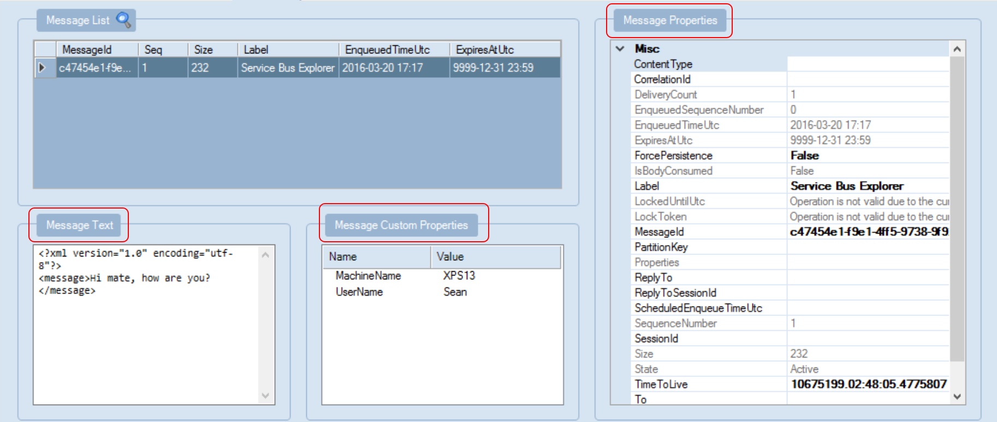
Brokered Message Properties

Slide 16
Send/Receive Messages
Receive and Delete
Message received and deleted in one operation (possible message loss) Message can’t be abandoned, deferred, or dead-lettered At-most-once delivery
Peek Lock
Two-phased receive (possible repeated message processing) Message can be abandoned, deferred, or dead lettered Receiver is responsible for completion At-least-once delivery
OnMessage
Multi-threaded message pump with controlled concurrency Messages can be auto-completed or completed manually Auto renewal of timeouts

Slide 17
BrokeredMessage & Client Types
BrokeredMessage
QueueClient
TopicClient
SubscriptionClient
MessageSender
MessageReceiver
MessageSender
MessageReceiver
QueueClient
QueueClient
Brokered
Message
TopicClient
SubscriptionClient

Slide 18
Peek Lock
Receive
Complete
Abandon
Defer
Deadletter
Lock timeout expired X MaxDeliveryCout
Message marked as completed and removed from the queue.
Message becomes visible on the queue and can be received again.
Message remains on the queue and will be received later.
Message is moved to deadletter sub-queue and can be received from that queue.
Message is moved to deadletter sub-queue and can be received from that queue.

Slide 19
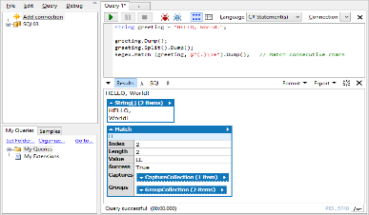
OnMessage API
Process
Complete Abandon Defer Deadletter
OnMessageOptions (AutoComplete , AutoRenewTimeout, MaxConcurrentCalls)
OnMessageOptions.ExceptionReceived
MessageReceivier/client.OnMessageAsync
Demo

Slide 20
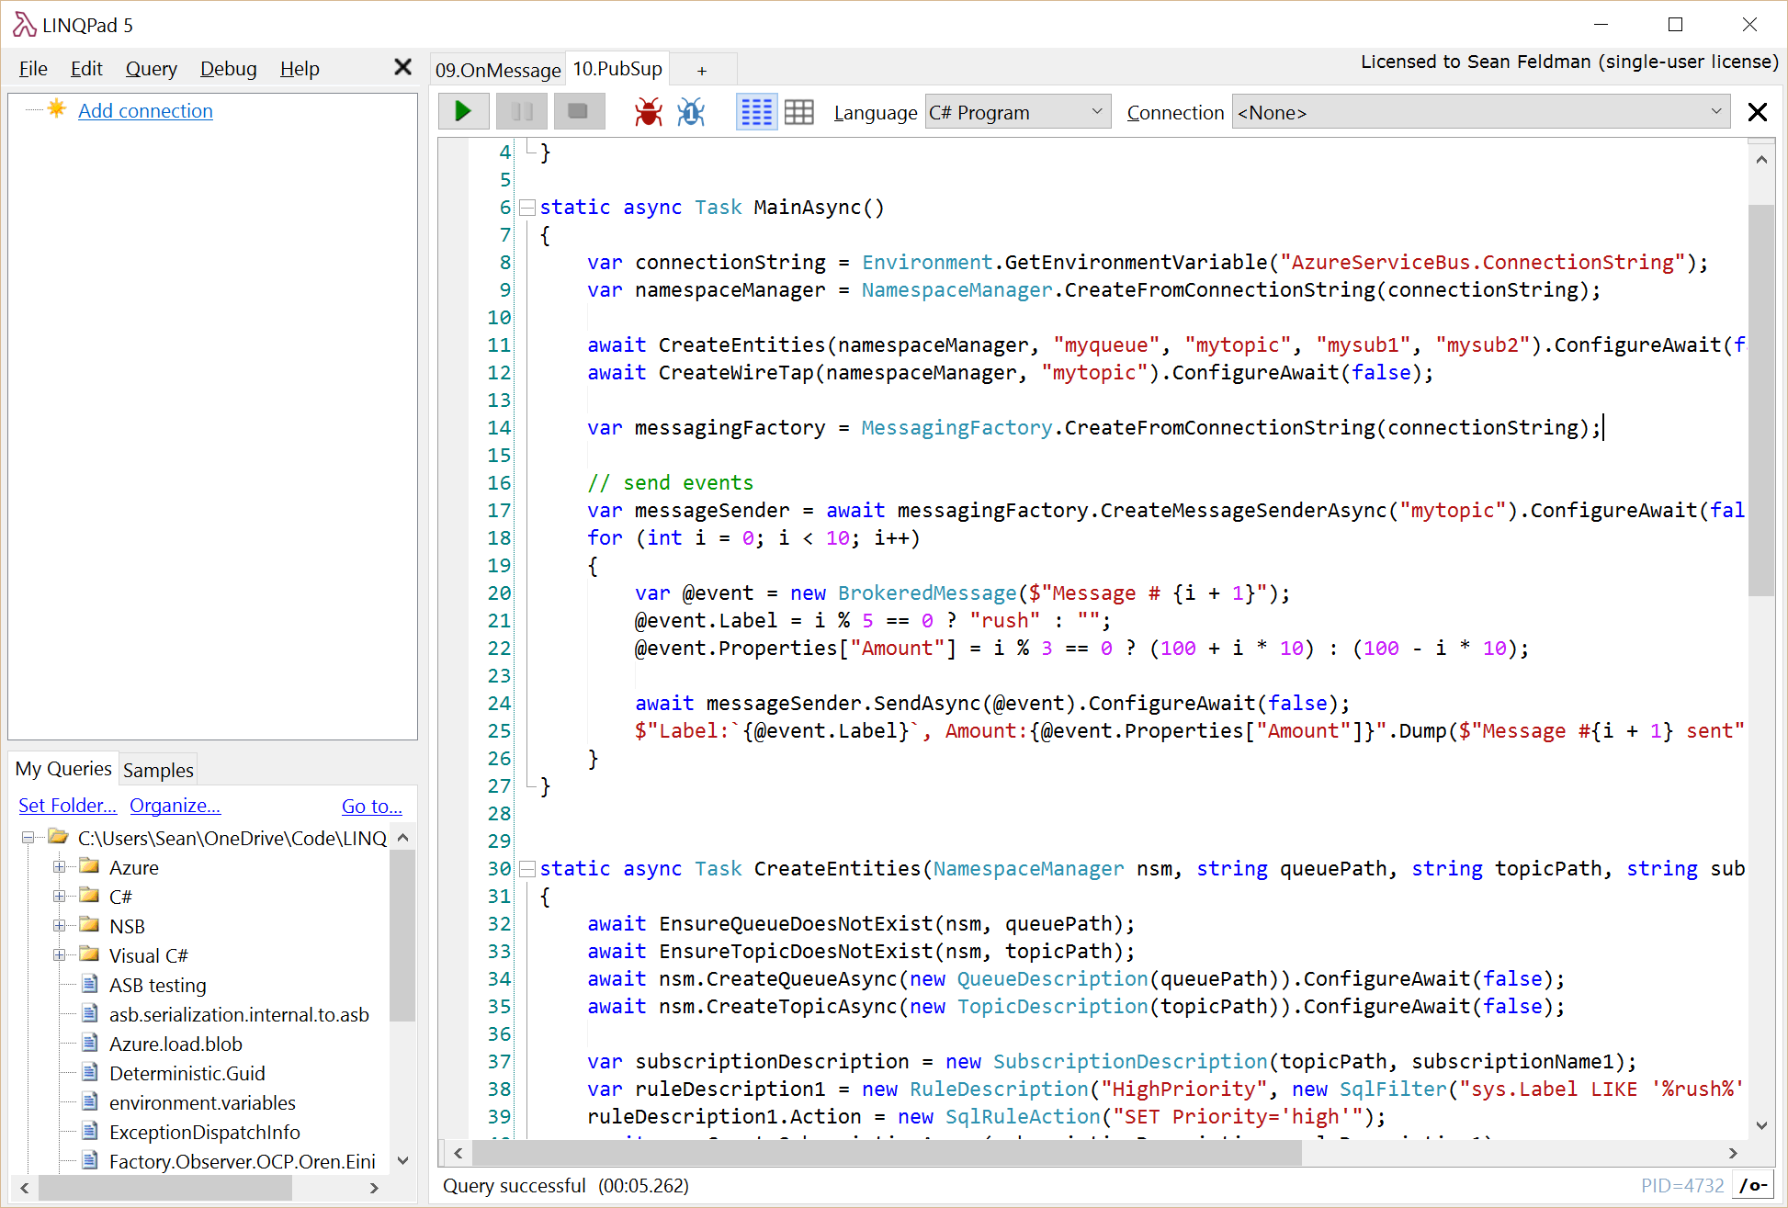
Pub/Sub
Topic: mytopic
Subscription: mysub1
sys.Label LIKE ‘%rush%’ OR Amount >= 100
Rules
Filter
HighPriority
SET Priority=‘high’
Action
Subscription: mysub1
Rules
(Amount < 100) AND (sys.Label NOT LIKE '%rush%')
Filter
NormalPriority
Action
SET Priority=‘normal’
Demo

Slide 21
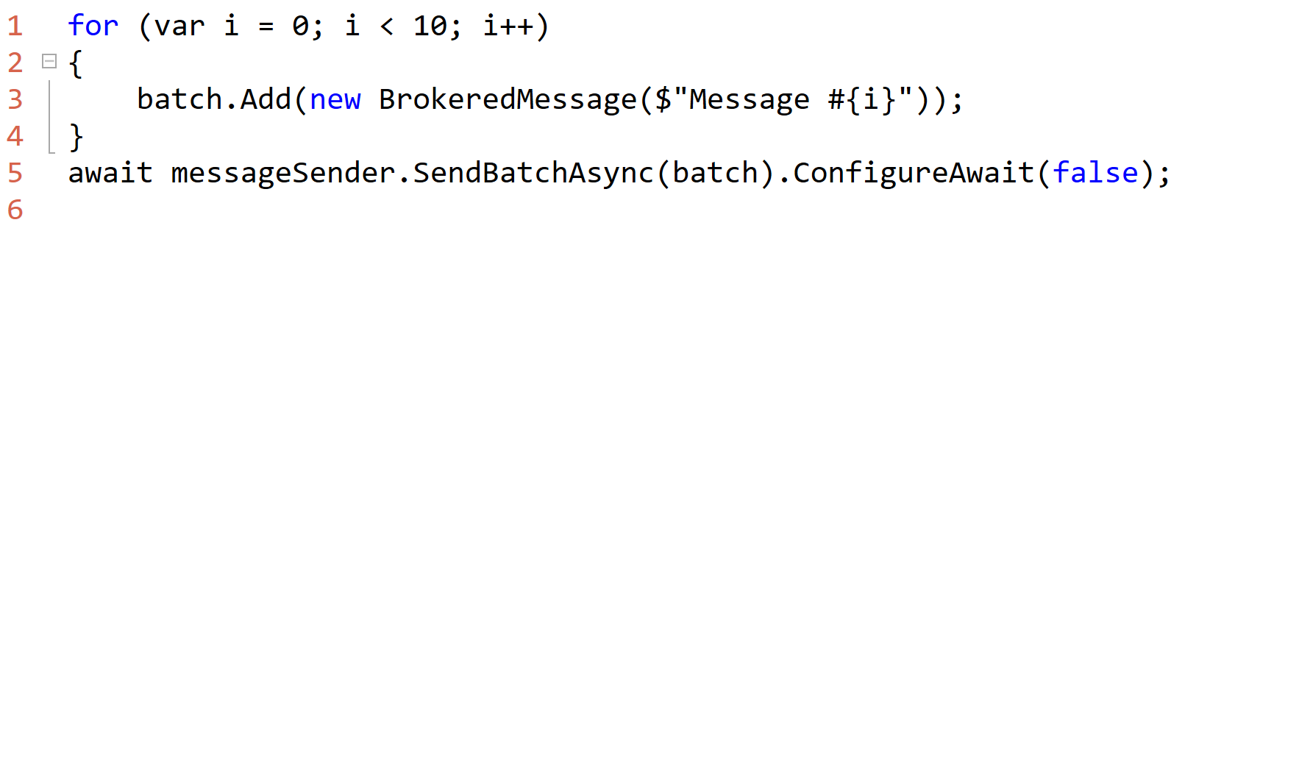
Batching

Slide 22
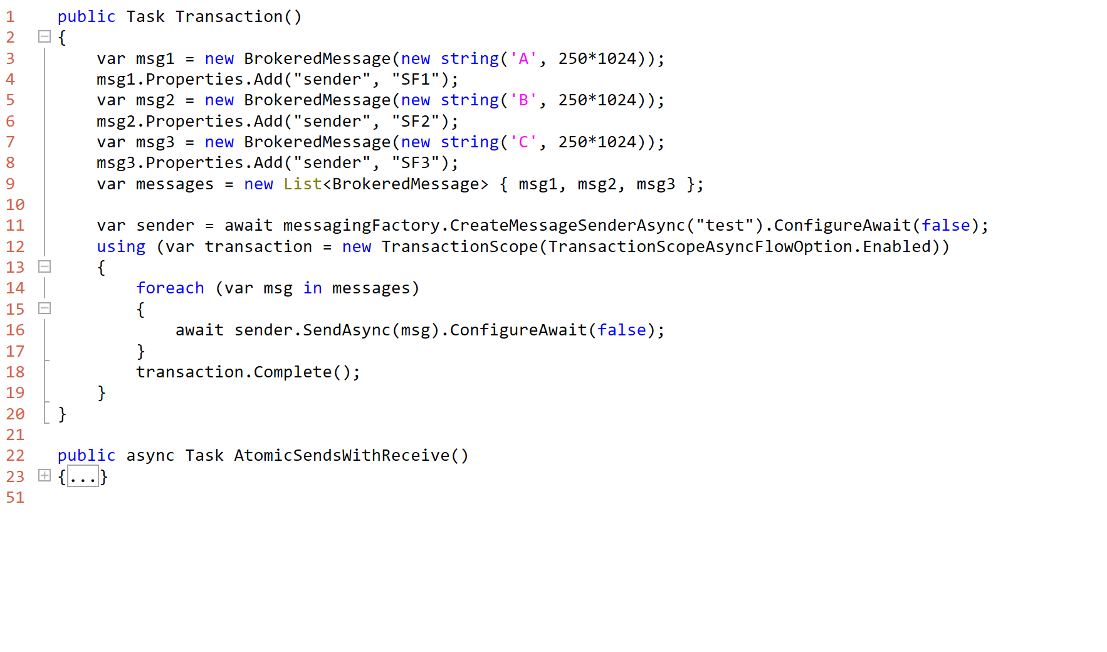
Transactions

Slide 23
Forwarding
Centralized DLQ sample
Dynamic property “DeadLetterSource”

Slide 24
Exception Handling
RetryPolicy
exception.IsTransient

Slide 25
HA and DR
PairedNamespaces
Active-Active
Active-Passive

Slide 26
A Word About Premium Tier
Isolated and dedicated environment
Per day billing
New data store engine (Storage based, not SQL)
1 MB Message size
No noisy neighbors
Low and predictable latency
High and predictable throughput
Express entities not supported (since there’s no need)

Slide 27
Tools
Cloud Tools for Visual Studio
Service Bus Explorer
ServiceBus 360

Slide 28

Thank you!
Slides & code https://github.com/SeanFeldman/ASB-AustinAzure
Recording http://usergroup.tv/?cat=498
Connect @sfeldman
Send your feedback to feldman.sean@gmail.com
Feel up your RSS feed with https://weblogs.asp.net/sfeldman
Tools
Service Bus Explorer https://github.com/paolosalvatori/ServiceBusExplorer
LinqPad https://www.linqpad.net/
ServiceBus 360 http://app.servicebus360.com/

